Slide 1


시각 Tech. 심화과정 (3) Lab session
연세대학교 컴퓨터과학과
신 창 하

Slide 2
Keras Intro
Input (None,784,)
Dense (None, 64,)
RELU
Dense (None, 64,)
High-level neural networks API.
Tensorflow.contrib 안에 들어감(tensorflow1.1부터)
RELU
Dense (None, 10,)
Softmax
Multilayer Perceptron Model
prediction(None,80,80,3)
from tensorflow.contrib.keras.api.keras.layers import Input, Dense
from tensorflow.contrib.keras.api.keras.models import Model # This returns a tensor
inputs = Input(shape=(784,)) # a layer instance is callable on a tensor, and returns a tensor
x = Dense(64, activation='relu')(inputs)
x = Dense(64, activation='relu')(x)
predictions = Dense(10, activation='softmax')(x) # This creates a model that includes # the Input layer and three Dense layers
model = Model(inputs=inputs, outputs=predictions) model.compile(optimizer='rmsprop', loss='categorical_crossentropy', metrics=['accuracy’])
model.fit(data, labels, batch_size=16) # starts training

Slide 3
Keras Intro
Fully Convolutional Network Model
from tensorflow.contrib.keras.api.keras.layers import Input, Conv2D
from tensorflow.contrib.keras.api.keras.models import Model # This returns a tensor
inputs = Input(shape=(80, 80, 3))
x = Conv2D(64, (3, 3), activation='relu')(inputs)
x = Conv2D (64, (3, 3), activation='relu')(x)
predictions = Conv2D(3, (3, 3), activation='relu')(x)
model = Model(inputs=inputs, outputs=predictions) model.compile(optimizer='adam', loss=‘mse')
model.fit(data, labels, batch_size=16, epochs=10)
Input (None,80,80,3)
Conv2d (None, 80,80,64)
RELU
Conv2d (None, 80,80,64)
RELU
Conv2d (None, 80,80,3)
RELU
prediction(None,80,80,3)

Slide 4
Keras Intro
Input (None,256,256,3)
1x1
1x1
MaxPool
3x3
5x5
1x1
Google Inception Module
Concatenate
from tensorflow.contrib.keras.api.keras.layers import Input, concatenate
from tensorflow.contrib.keras.api.keras.layers import Conv2D, MaxPooling2D
from tensorflow.contrib.keras.api.keras.models import Model
input_img = Input(shape=(256, 256, 3))
tower_1 = Conv2D(64, (1, 1), padding='same’, activation='relu', name='t1-1')(input_img)
tower_1 = Conv2D(64, (3, 3), padding='same', activation='relu', name=‘t1-2')(tower_1)
tower_2 = Conv2D(64, (1, 1), padding='same', activation='relu', name=‘t2-1')(input_img)
tower_2 = Conv2D(64, (5, 5), padding='same', activation='relu', name=‘t2-2')(tower_2)
tower_3 = MaxPooling2D((3, 3), strides=(1, 1), padding='same', name=‘t3-1')(input_img)
tower_3 = Conv2D(64, (1, 1), padding='same', activation='relu', name=‘t3-2')(tower_3)
output = concatenate([tower_1, tower_2, tower_3], axis=1, name=‘concatenate_t123')
model = Model(inputs= [input_img], outputs= [output])
model.summary()
>>>

Slide 5
Keras Intro
High-level neural networks API.
Tensorflow.contrib 안에 들어감(tensorflow1.1부터)
자주 쓰는 함수 .shape
from tensorflow.contrib.keras.api.keras.layers import Input, concatenate
from tensorflow.contrib.keras.api.keras.layers import Conv2D, MaxPooling2D, BatchNormalization, Activation
from tensorflow.contrib.keras.api.keras.models import Model
input_img = Input(shape=(256, 256, 3))
tower_1 = Conv2D(64, (3, 3), padding='valid', activation='relu')(input_img)
print(tower_1.shape) # valid 조건 사용할 때 특정 레이어에서의 차원 확인할 때 유용함
>>>

Slide 6
Keras Intro
High-level neural networks API.
Tensorflow.contrib 안에 들어감(tensorflow1.1부터)
자주 쓰는 레이어: BatchNormalization, Dropout
from tensorflow.contrib.keras.api.keras.layers import Input, concatenate
from tensorflow.contrib.keras.api.keras.layers import Conv2D, MaxPooling2D, BatchNormalization, Activation, Dropout
from tensorflow.contrib.keras.api.keras.models import Model
input_img = Input(shape=(256, 256, 3))
tower_1 = Conv2D(64, (3, 3), padding='same', activation='relu')(input_img)
tower_1 = BatchNormalization(axis=-1)(tower_1)
tower_1 = Dropout(0.2)(tower_1) # 0.2는 dropout 비율을 의미함.
predictions = Conv2D(1, (3, 3), padding='same')(tower_1)
model = Model(inputs= [input_img], outputs= [predictions])

Slide 7
Keras Intro
High-level neural networks API.
Tensorflow.contrib 안에 들어감(tensorflow1.1부터)
자주 쓰는 함수: model.fit
from tensorflow.contrib.keras.api.keras.layers import Input, Conv2D
from tensorflow.contrib.keras.api.keras.models import Model
Import numpy as np
input_img = Input(shape=(256, 256, 3))
output = Conv2D(3, (3, 3), padding='valid')(input_img)
model = Model(inputs= [input_img], outputs= [output])
input_sample=np.ones((160,256,256,3))+0.01*np.random.rand(160,256,256,3)
output_sample=2*np.ones((160,256,256,3))
model.compile(optimizer='adam', loss='mse')
model.fit(input_sample, output_sample, batch_size=8, epochs=20)
input, output size는 틀린 곳이 없다면 어디를 수정해야 에러가 나지 않을까?

Slide 8
Keras Intro
High-level neural networks API.
Tensorflow.contrib 안에 들어감(tensorflow1.1부터)
자주 쓰는 함수: model.fit_generator
batch_sz, patch_h, patch_w = 16, 256, 256
def dataGenerator(batch_size, patch_h, patch_w):
while 1:
input_batch =np.ones((batch_size, patch_h, patch_w,3))+ 0.01*np.random.rand(batch_size, patch_h, patch_w,3)
output_batch =2*np.ones((batch_size, patch_h, patch_w,3))
yield(input_batch, output_batch)
my_generator= dataGenerator(batch_sz, patch_h, patch_w)
model.fit_generator(my_generator, steps_per_epoch=100)

Slide 9
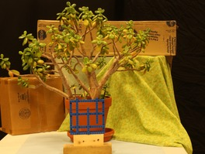
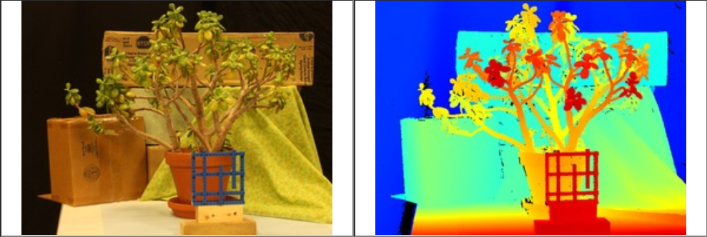
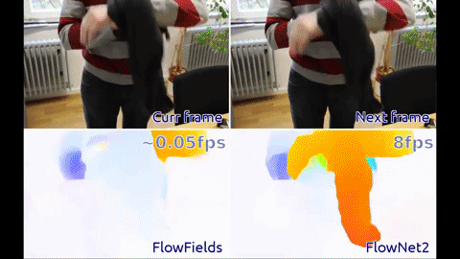
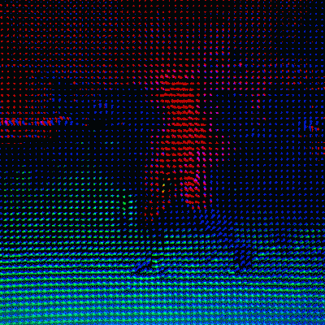
Contents
Depth estimation from stereo images
Optical flow estimation
Left
Right
disp

Slide 10
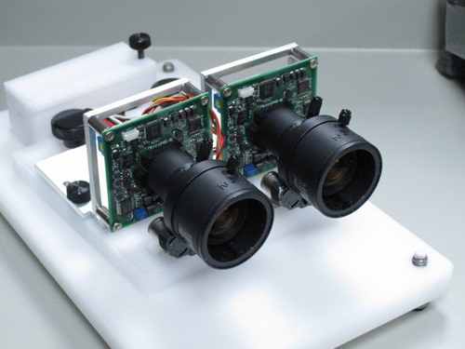
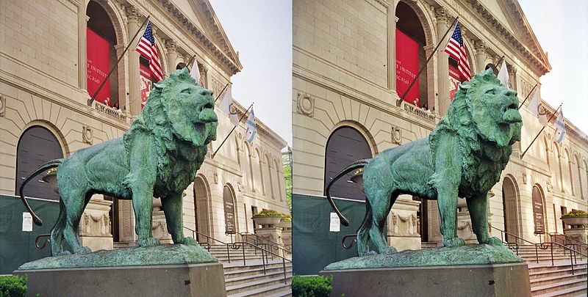
Stereo
Left / Right image
Compute pixel-wise disparity
Left
Right

Slide 11
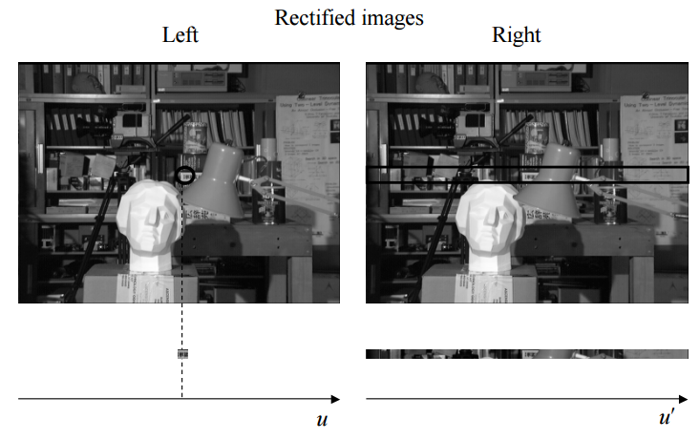
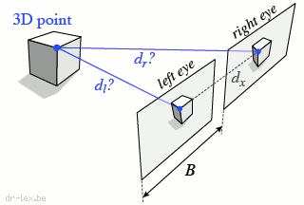
Stereo Matching(Triangulation)
Left / Right image
Compute pixel-wise disparity(Horizontal)
http://www.ece.ucsb.edu/~manj/ece181bS04/L14(morestereo).pdf

Slide 12
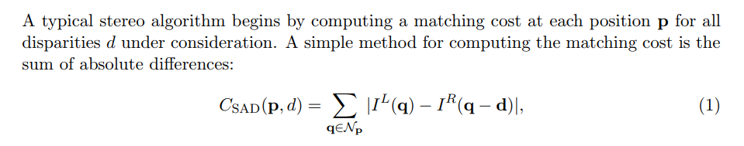
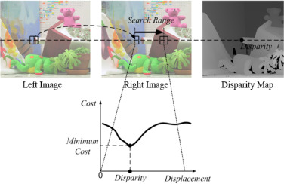
Stereo Matching(Triangulation)
Input: Left / Right image → Output: Pixel-wise Disparity
Zbontar, Jure, and Yann LeCun. "Stereo matching by training a convolutional neural network to compare image patches." Journal of Machine Learning Research 17.1-32 (2016): 2.

Slide 13

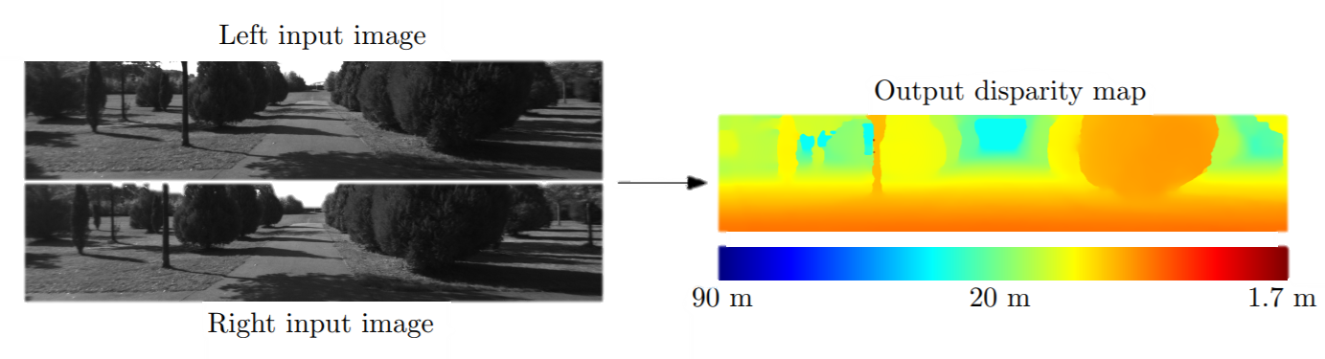
Stereo Matching(in NN)
Input: Left / Right image → Output: Pixel-wise Disparity
Zbontar, Jure, and Yann LeCun. "Stereo matching by training a convolutional neural network to compare image patches." Journal of Machine Learning Research 17.1-32 (2016): 2.

Slide 14
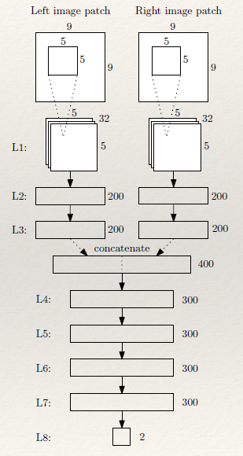
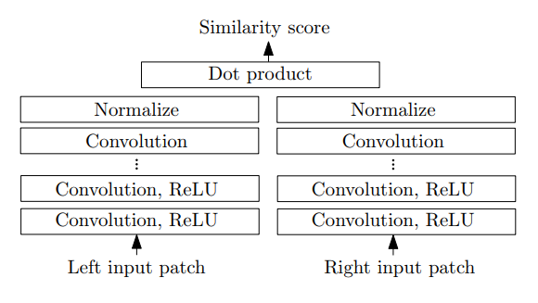
Stereo Matching(in NN)
Input: Left / Right image → Output: Pixel-wise Disparity
Zbontar, Jure, and Yann LeCun. "Stereo matching by training a convolutional neural network to compare image patches." Journal of Machine Learning Research 17.1-32 (2016): 2.

Slide 15
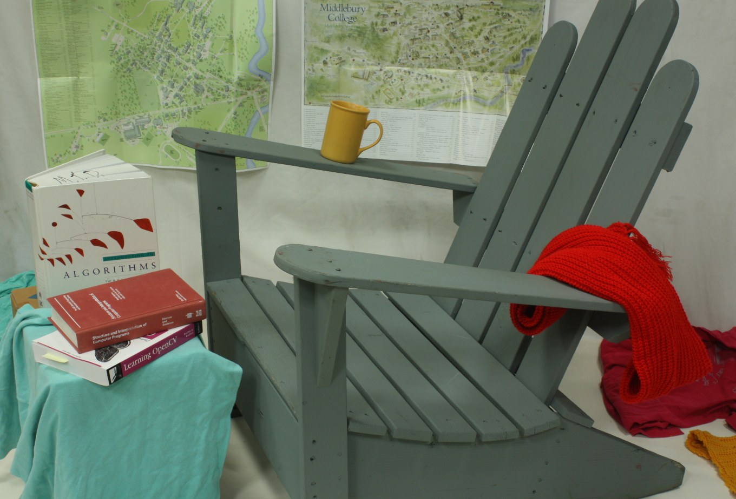
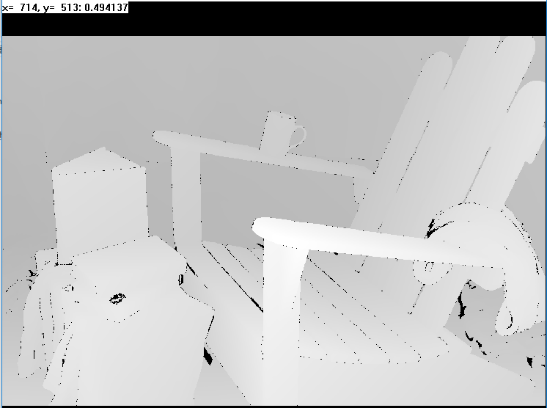
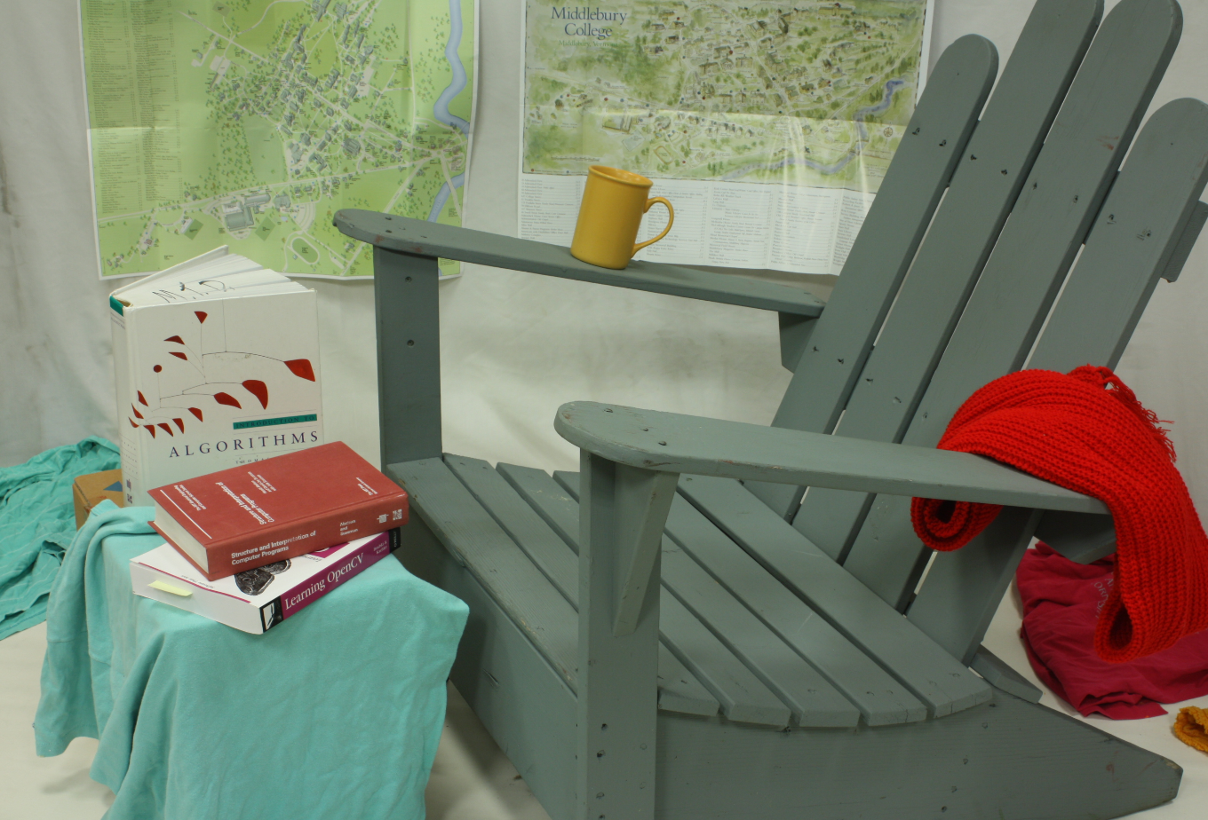
Stereo Matching
간단한 FCN 네트워크로 가정.
Con2d, BN, RELU만으로 구성됨.
왼쪽/오른쪽 이미지를 스택하여 NxNx6로 인풋 설정.
Image_R
NxNx3
Image_R
Image_R
CONV+RELU
CONV+RELU
CONV+RELU
CONV+RELU
Disparity
NxNx3
Image_L
Image_L
Image_L
Stack
NxNx6
Training Data

Slide 16
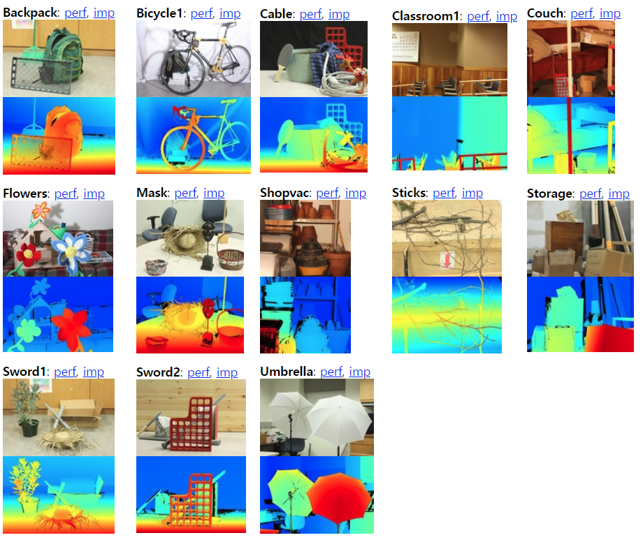
Stereo Matching
Middlebury stereo dataset.
우리는 크기 동일하게 맞춘 이미지들을 트레이닝에 사용 shape= (116,170,3)
Training Data
Occlusion Map
0<=Disparity<=18.37px

Slide 17
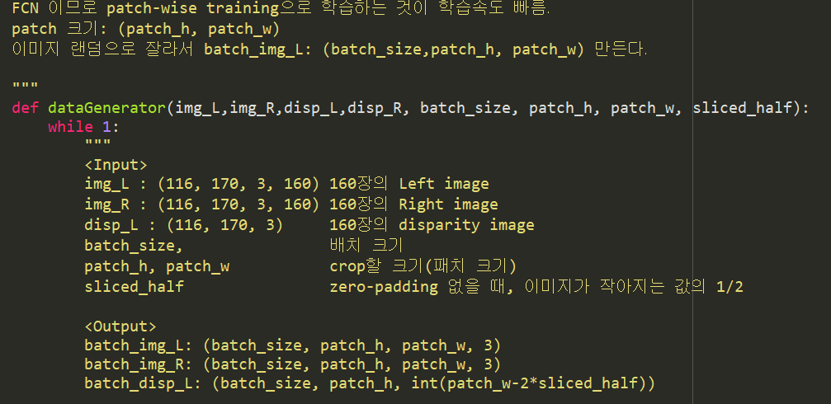
Stereo Matching
데이터 생성(dataGenerator) 코드 만들기
116*170*3 이미지 중 일부(ex. 31x31x3) 씩 트레이닝 데이터를 만들어 학습.
FCN에서 흔히 사용되는 기법임.

Slide 18
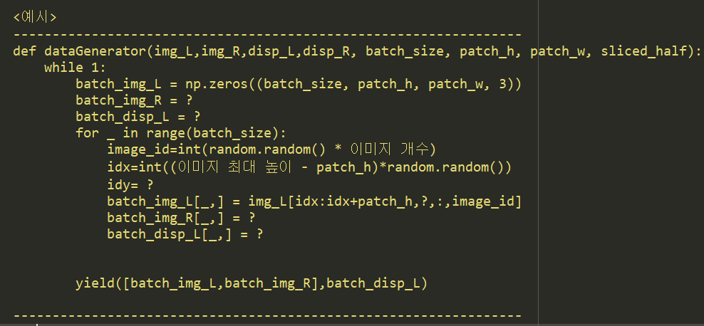
Stereo Matching
데이터 생성(dataGenerator) 코드 만들기
116*170*3 이미지 중 일부(ex. 31x31x3) 씩 트레이닝 데이터를 만들어 학습.
FCN에서 흔히 사용되는 기법임.

Slide 19
Stereo Matching
간단한 FCN 네트워크 설계하기.
Layer1: 왼쪽/오른쪽 이미지를 concatenate하여 NxNx6로 만들어준다.
Con2d, BN, RELU만으로 구성됨.
네트워크 설계 시 고려할 사항.
img_L , disp_L, img_R, disp_R 는 각각 이미지와 깊이 데이터임.
img_L.shape=(116,170,3,160): 이미지 크기는 116*170*3.
disp_L.shape=(116,170,160)
disp_L.max() = 18.37px
CONV
CONV
CONV
CONV
Receptive Field는
최소한 x 이상
이어야 트레이닝이 가능하다.
(L/R 이미지는 수평 축으로만 이동하여 촬영했다고 가정.)

Slide 20
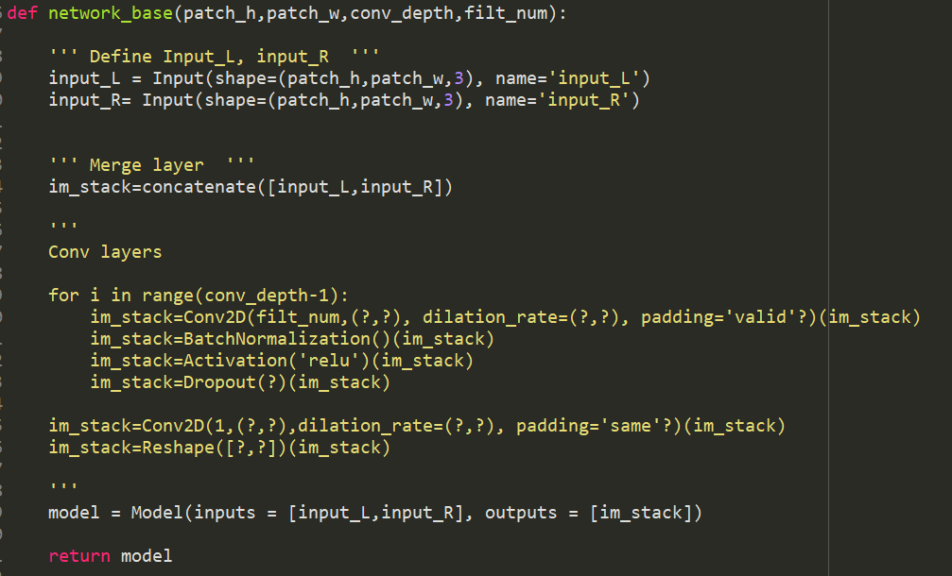
Stereo Matching
간단한 FCN 네트워크 설계하기.

Slide 21
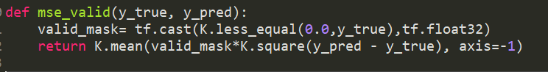
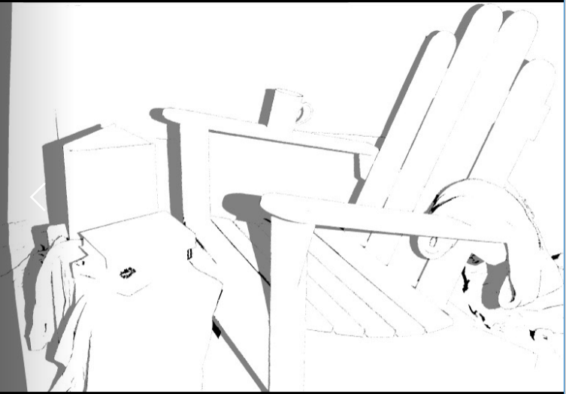
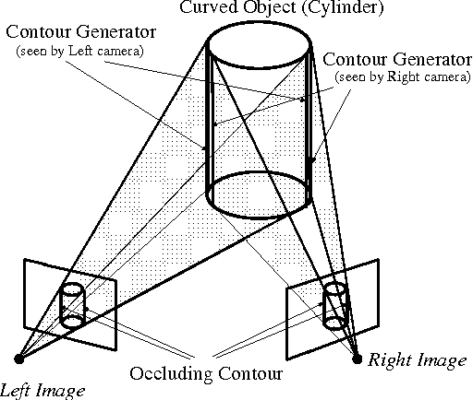
Define custom loss
Disparity map에서 안 채워진 곳이 존재. disp <0
Occlusion 있는 곳(disp<0)은 update 하지 않도록 하는 loss function 정의

Slide 22
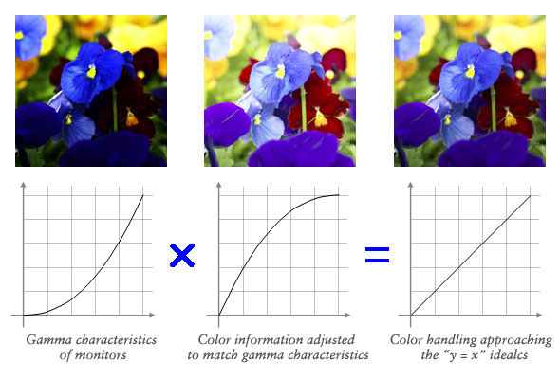
Augmentation
color
랜덤크롭
180도 회전, Updownflip
Zbontar, Jure, and Yann LeCun. "Stereo matching by training a convolutional neural network to compare image patches." Journal of Machine Learning Research 17.1-32 (2016): 2.

Slide 23
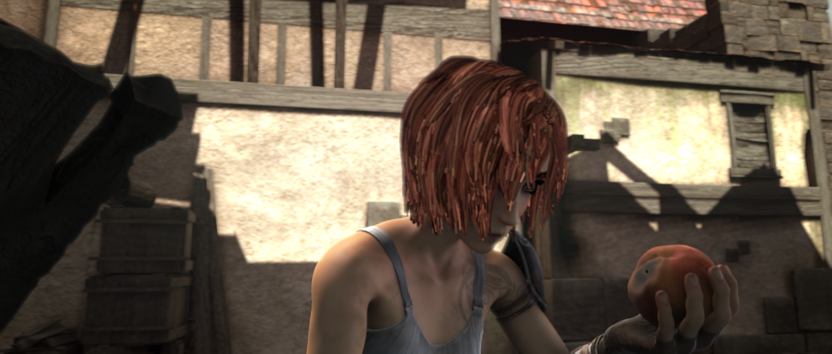
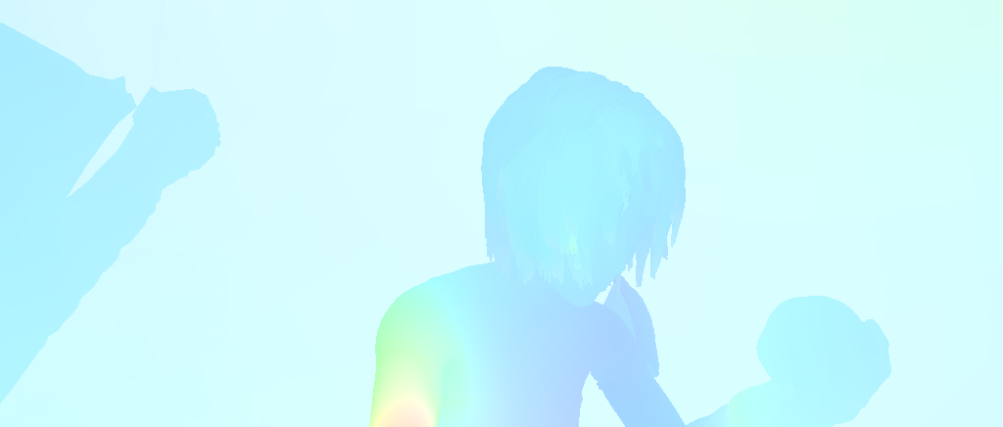

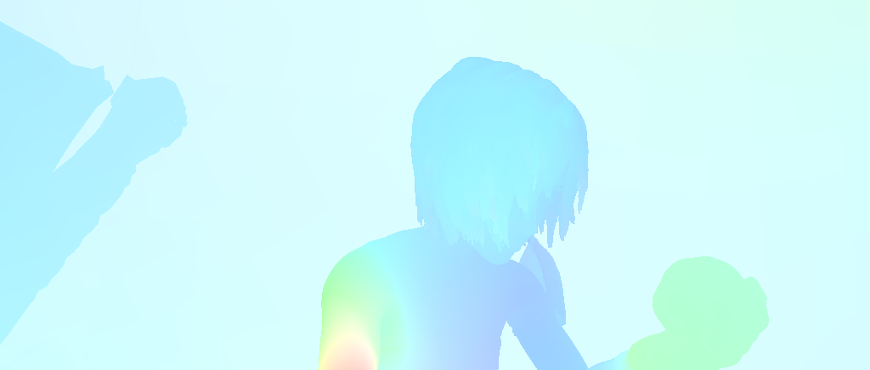
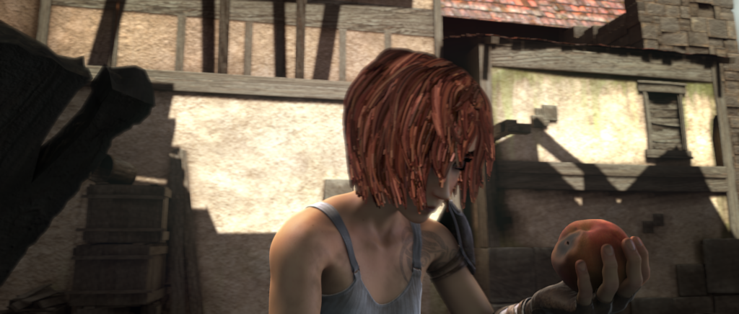
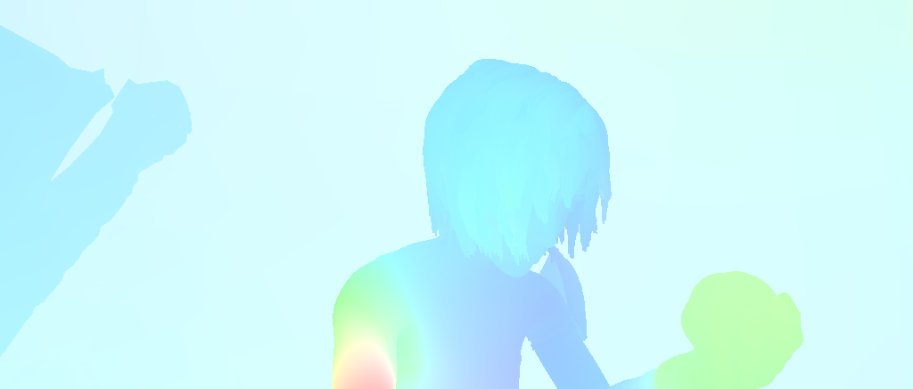
Optical flow
Input: 이전/현재 프레임 이미지 (MxNx3), (MxNx3)
Output: 각 픽셀에서의 x, y축 이동거리(MxNx2)

Slide 24
Optical flow
Input: 이전/현재 프레임 이미지 (MxNx3), (MxNx3)
Output: 각 픽셀에서의 x, y축 이동거리(MxNx2)
각 픽셀이 가로세로로 모두 이동하므로 최대 이동거리 커버하도록
receptive field 만들어줘야 함(3x3, 5x5 등의 형태로 )
Receptive field
Receptive field
CONV+RELU
CONV+RELU
CONV+RELU
CONV+RELU
Stereo
Optical flow

Slide 25
Optical flow
Input: 이전/현재 프레임 이미지 (MxNx3), (MxNx3)
Output: 각 픽셀에서의 x, y축 이동거리(MxNx2)
각 픽셀이 가로세로로 모두 이동하므로 최대 이동거리 커버하도록
receptive field 만들어줘야 함(3x3, 5x5 등의 형태로 )

Slide 26
Optical flow
Input: 이전/현재 프레임 이미지 (MxNx3), (MxNx3)
Output: 각 픽셀에서의 x, y축 이동거리(MxNx2)
각 픽셀이 가로세로로 모두 이동하므로 최대 이동거리 커버하도록
receptive field 만들어줘야 함(3x3, 5x5 등의 형태로 )

Slide 27
Optical flow
Input: 이전/현재 프레임 이미지 (MxNx3), (MxNx3)
Output: 각 픽셀에서의 x, y축 이동거리(MxNx2)
각 픽셀이 가로세로로 모두 이동하므로 최대 이동거리 커버하도록
receptive field 만들어줘야 함(3x3, 5x5 등의 형태로 )
Residual connection on a convolution layer
from tensorflow.contrib.keras.api.keras.layers import Conv2D, Input
from tensorflow.contrib.keras.api.keras.layers import add
# input tensor (3-channel 256x256 image)
x = Input(shape=(256, 256, 3))# 3x3 conv with 3 output channels(=input channels)
y = Conv2D(3, (3, 3), padding='same')(x)
z = add([x, y]) # this returns x + y.

Slide 28
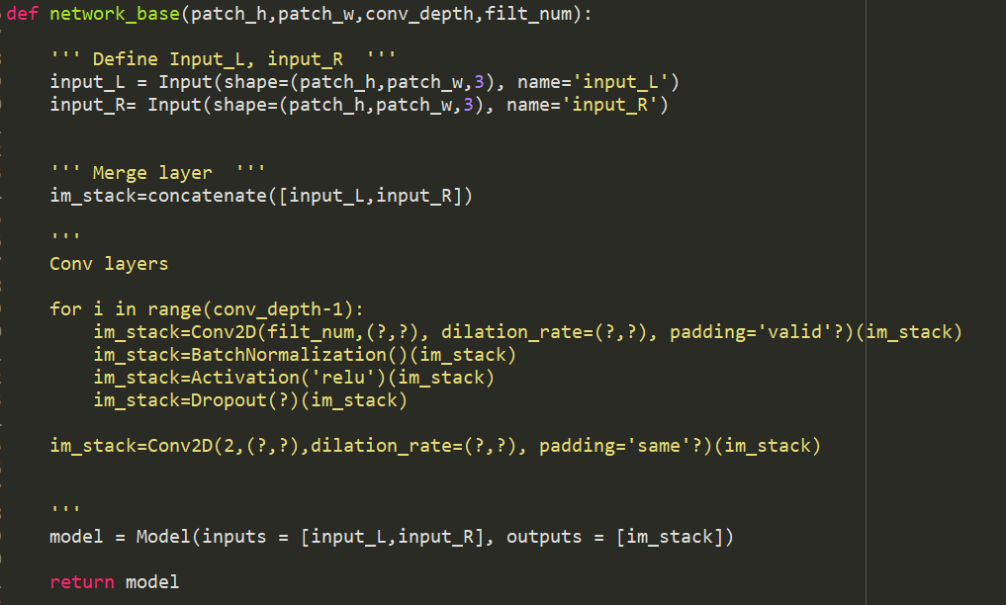
Optical flow
간단한 FCN 네트워크 설계하기.
Layer1: 왼쪽/오른쪽 이미지를 concatenate하여 NxNx6로 만들어줌
Con2d, BN, RELU만으로 구성됨.
Residual network 구현

